Slide 1
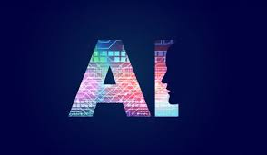

GENERATIVE AI TOOLS
SUBMITTED BY:- TARUN KUMAR
BRANCH :- AI&ML
ROLL NO. :- 2322806
SUBMETTED TO :- Mr. DEVASHISH SIR

Slide 2
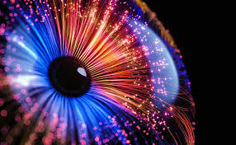

Slide 3
Types of AI tools :-
Craiyon
Synthesia
Veed.io
Deep dream by google
Deepart by prisma lab

Slide 4

Crayon AI uses advanced technologies like Generative Adversarial Networks (GANs) to generate images. GANs consist of a generator that creates images and a discriminator that evaluates their realism. These models are trained on large datasets to learn patterns and create realistic images across various applications, from art to medical imaging. Users interact with Crayon AI through its platform or API to generate images tailored to their needs or preferences.

Slide 5
How do you create realistic images with AI?
Creating realistic images with AI starts with, you guessed it right... the prompts.
You're going to learn our best hacks to turn your words in to super realistic images.
Here are some friendly tips when making photorealistic AI images.

Slide 6
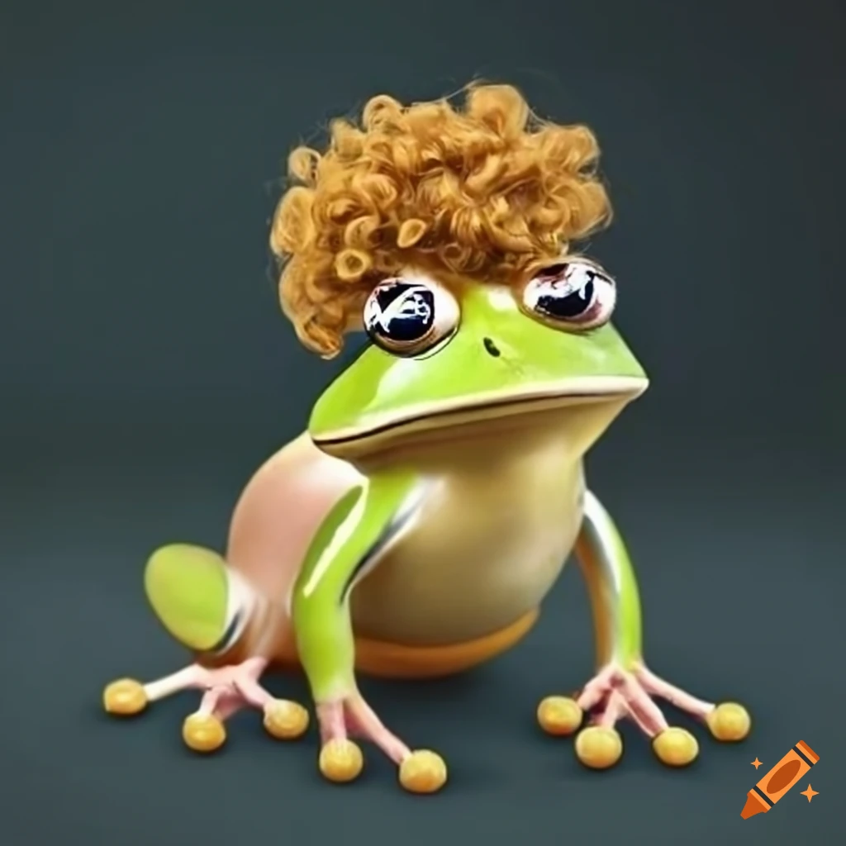
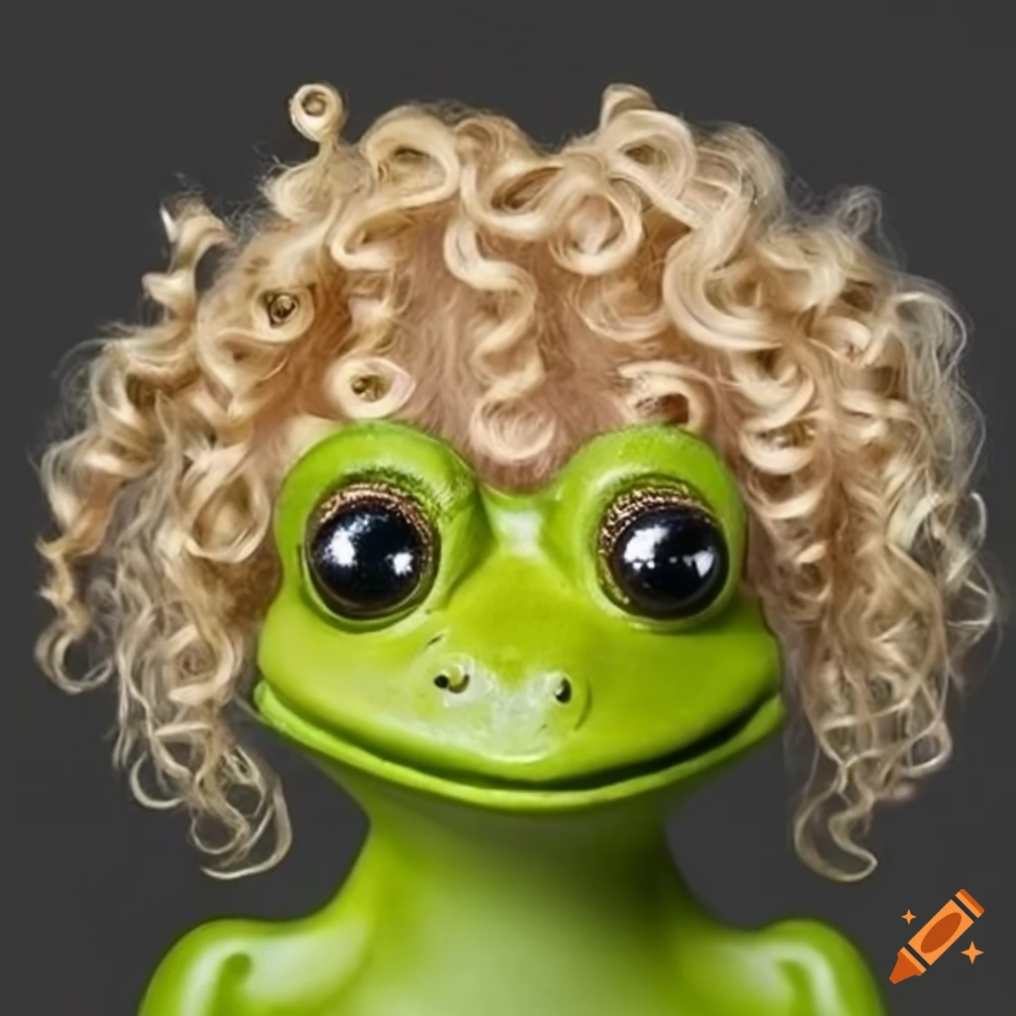
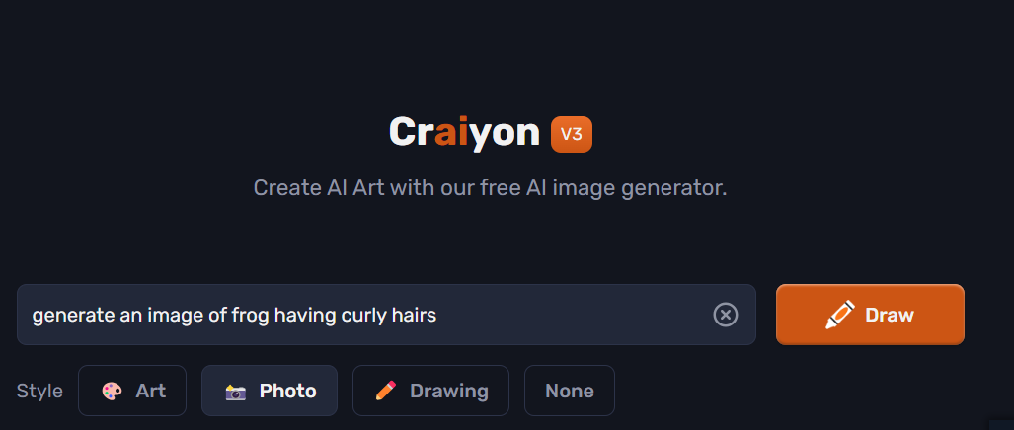
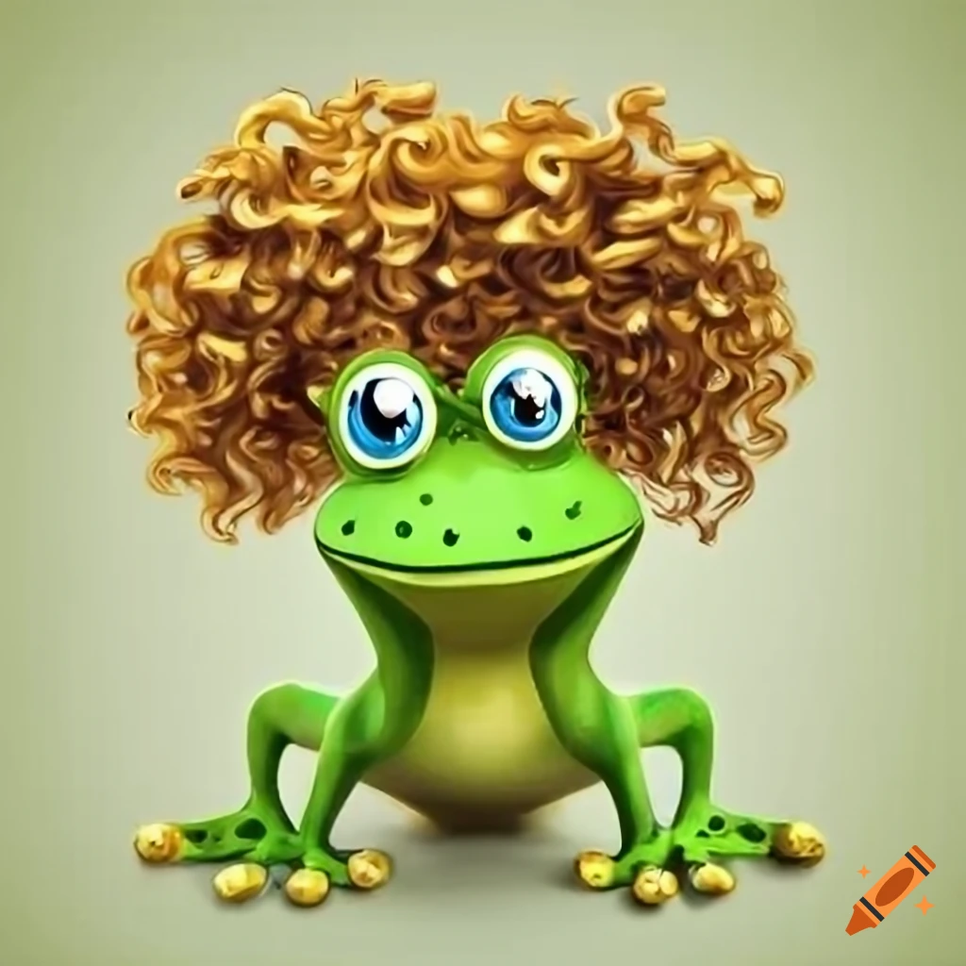

Slide 7

Deep Dream is a program from Google that makes images look trippy by enhancing patterns it finds in them. It uses artificial intelligence to create dream-like visuals with lots of swirling shapes and colors.

Slide 8
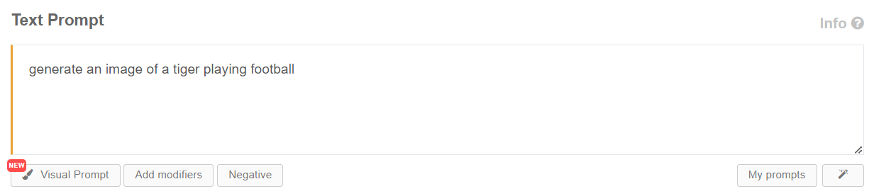
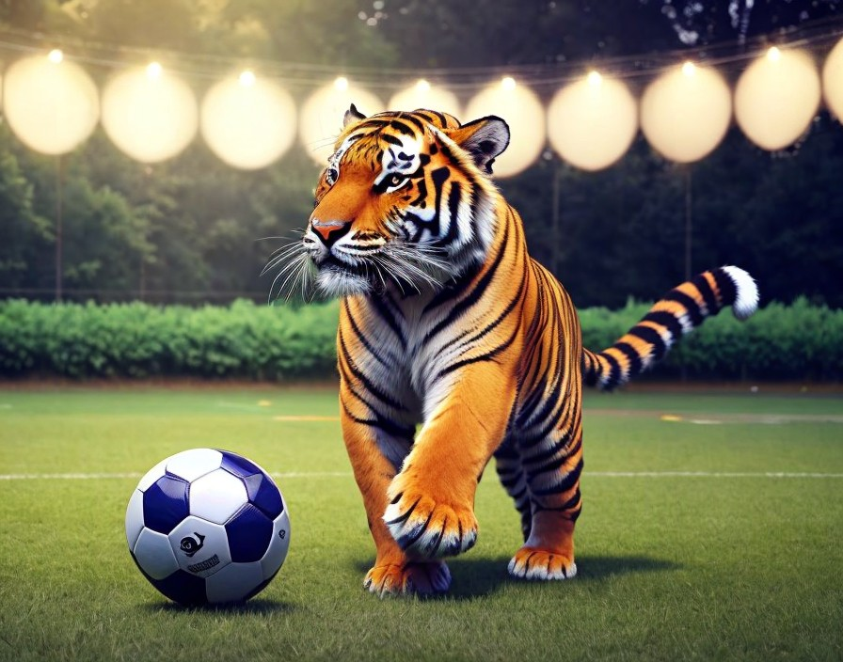

Slide 9

Veed.ai is a tool that simplifies video editing using artificial intelligence. It offers features like automatic subtitles, video trimming, adding text and animations, and converting audio to text. This makes it easier for users to create and customize videos without needing advanced editing skills.

Slide 10

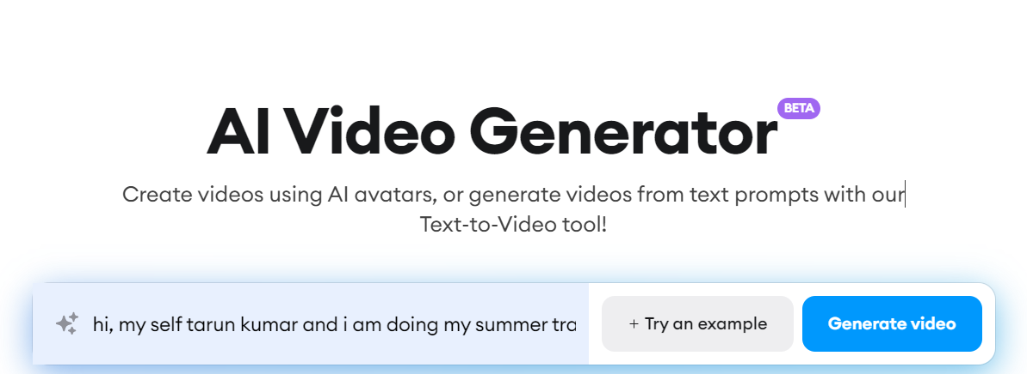

Slide 11

Synthesia is a tool that uses AI to make videos of people talking, just from written text. It makes the person's face move and their lips sync up with the words, like they're really speaking. It's used for making videos, language learning, and helping people understand things better.

Slide 12
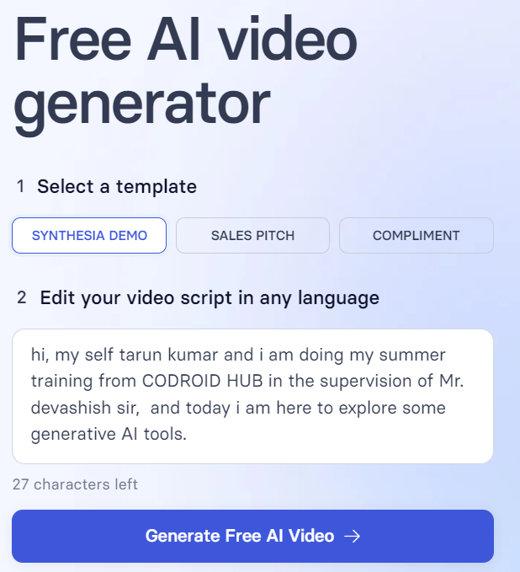
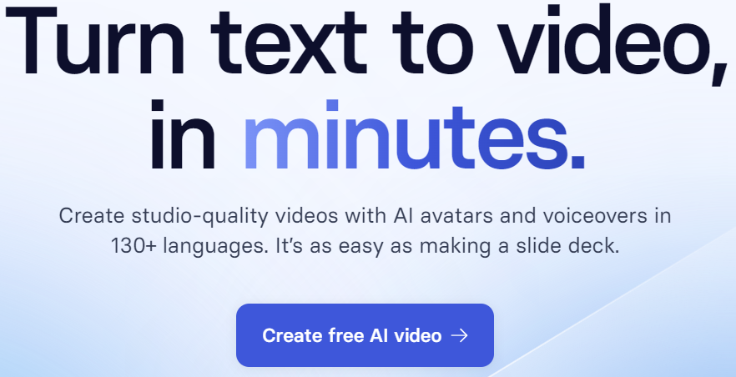

Slide 13

Prisma Lab is a photo editing tool that uses AI to turn your photos into beautiful artworks inspired by famous artists. It applies artistic filters to your pictures, making them look unique and eye-catching with just a few taps.

Slide 14
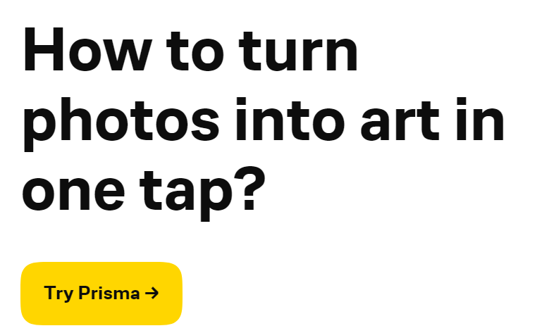

Slide 15
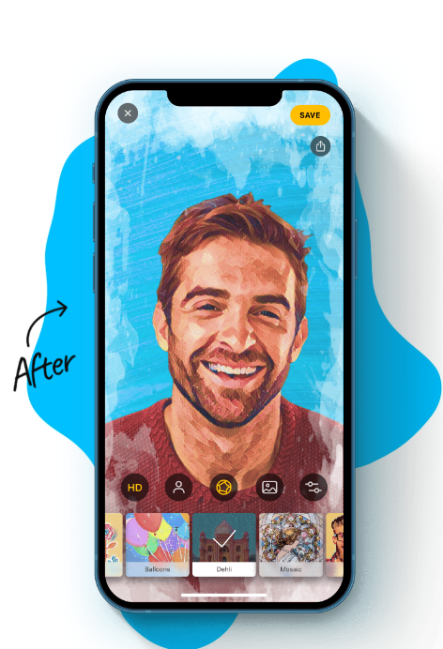
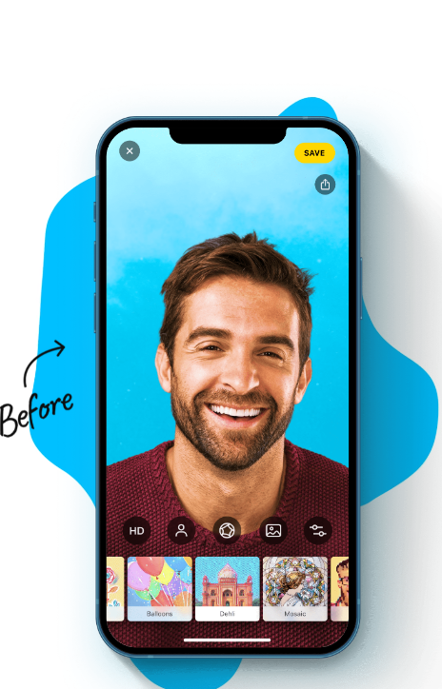

Slide 16
Simple Program to Add Two Numbers
ALGORITHM :-
1. Start
2. Input num1
3. Input num2
4. sum = num1 + num2
5. Print sum
6. End
OUTPUT :-
# Step 1: Start (No specific code for this step)
# Step 2: Input num1
num1 = float(input("Enter the first number: ")) # Using float to handle decimal inputs
# Step 3: Input num2
num2 = float(input("Enter the second number: ")) # Using float to handle decimal inputs
# Step 4: sum = num1 + num2
sum = num1 + num2
# Step 5: Print sum
print("The sum of", num1, "and", num2, "is:", sum)
# Step 6: End (No specific code for this step)

Slide 17

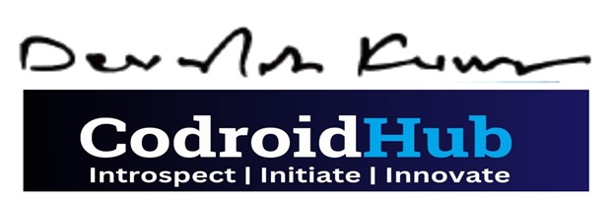
Founder, CodroidHub Private Limited

